Slide 1
ONLINE FIRST INFORMATION REPORT FILING SYSTEM
Submitted by
Y.Snehitha (16AJ1A05B1)
M.Karuna (16AJ1A0571)
N.Mounika (16AJ1A0578)
S.Sunilprasad (16AJ1A0594)
Guided by
Mrs.A.Durga Bhavani

Slide 2
CONTENT
Abstract
Introduction
Existing System
Proposed System
Dataflow Diagrams
Implementation
Result
Conclusion
References

Slide 3
Abstract
The aim of this project and implementation is to develop interactive online first information report system which is easily accessible to the public.
The rate of crimes is increasing day by day in all societie across the world, but we do believe that there is a lot which can be done by both the governments and the individuals to reduce the crimes in communities.
This project has 2 modules:
1. Admin 2. User
The police deportment use manual method for storing data and processing criminal information which is a time taking process, which will causes chances of losing information.
In this system data is maintained in the form of records.
There are so many categories that a user can file:
1. Missing 2. Robbery 3. kidnap 4. accidents 5. Eve –Teasing etc..

Slide 4
ADMIN MODULE
View and reply user complaints.
View and reply user crimes.
Add, delete and hide latest hot news.
View and delete user’s feedback.
Add, delete and view most wanted persons.
Add, delete and view missing persons.
Add and view criminal registration.
Send message to user.
Change password.

Slide 5
USER MODULE
Add online complaints.
Check complaint status.
Edit complaints.
Add missing person report.
Ask questions.
Send messages.
Give feedbacks.
Change password.

Slide 6
Team module
The Team module includes
Team can login their account by team name and team id.
Team can see their allotted word and start investigation.
Team can upload and download evidences.

Slide 7
Project Keywords:
Criminal History
Minimum time
Crime
Tools:
Software requirement:-
Languages : PHP
Front End : HTML, JavaScript
Platform : Xammp
Web Servers : Localhost
Backend : My SQL

Slide 8
Project Objectives:
The main objective of the FIR is to manage the details of crime, criminal.
The project is totally built at administrative end and thus only the administrator is to access.
To reduce the manual work.
Manage the information of solutions.

Slide 9
Project Outcome:
To file the OFIR from any place.
FIR is a very important as we sets the process of criminal justices of in motion.
Project Scope:
To easily accessible to the people.
This system provides proper security and reduces the manual work.
Minimum time needed for the various processing.
User friendliness and interactive.

Slide 10
Existing System:
In the existing system only we can see the details of particular information about the police stations in our state, the existing system has more workload for the authorized person, but in the case of proposed system, the user can registered in our site and send the crime report and complaint about a particular city or person.
More man power.
Time consuming.
Needs manual calculations
The size of the database increases day by day, increasing the load on the database

Slide 11
All criminal records are stored in a file.
To add any new record ,record file is used.
When other police station require any criminal information at that time they need to call that police station.
Citizens cannot get the information and the current status of the criminals of all cities.
Damage of machines due to lack of attention.

Slide 12
No direct rules for the higher officials.
To avoid all these limitations and make the working more accurately system need to be one step advance computerized.

Slide 13
Proposed System:
The aim of proposed system is to develop a system of improved facilities. The manual system has some drawbacks which can be overcome by using web based software.
The following reasons explain by it is needed:
The system provides proper security and reduces the manual work.
Citizens no need to go to the police station.
Visitor can easily get the information about the crime and criminal.

Slide 14
Reduce the man power.
Reduces the time.
They can directly see information on site.
Member can view the current status of the crime investigation.

Slide 15
Data flow Diagrams
Crime ManagementSystem
UserID, Complaints
Complaint Management
User
Administrator
Solutions, Feedback
User
Registration
User
Registration
Username/Password
Login
Username/Password
Login
Verify
Complaints
Complaint Registration
Complaints

Slide 16
Administrator
Administrator
Registration details
User name, Password
View user details
Login
Crime System
View Complaints
Complaints
Add Solutions
View Feedback
User
Feedback
Add FIR Reports
Add mortem analysis
FIR
Mortem Details

Slide 17
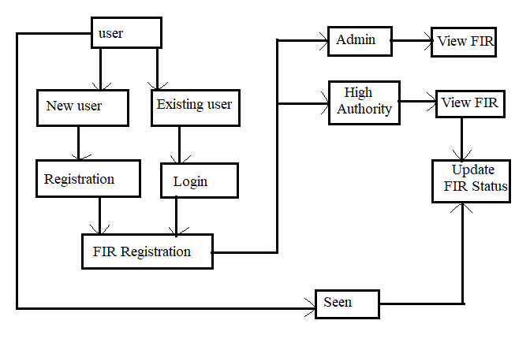
Processing:

Slide 18
FUTURE SCOPE
In future system will provide mail facility to editors. Editors can send mail to other stations editor.
In future system will allow user to register complains online.
In future system will provide facility to send message.
Users can view the progress of their complaint online.
By the technology user can view the case details and progress of the complaints on their mobile phones.

Slide 19
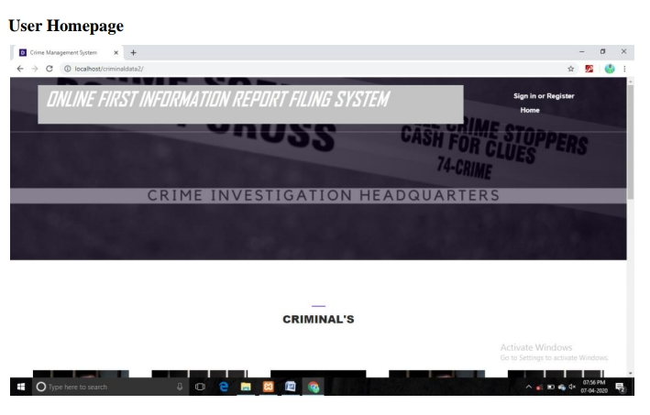
Results

Slide 20

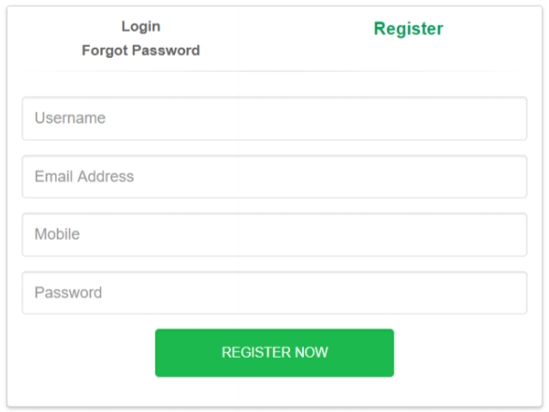
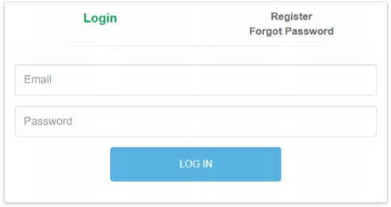

Slide 21
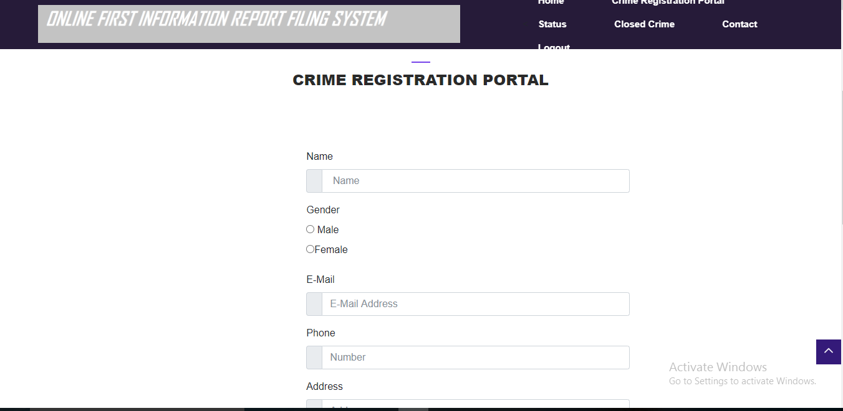
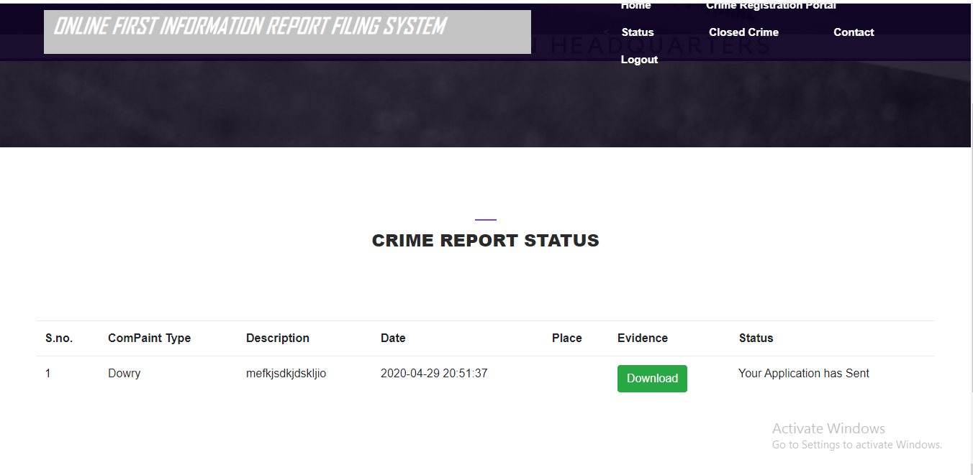
Status

Slide 22
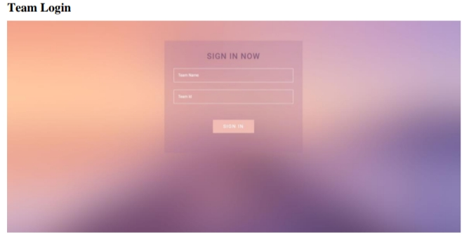

Slide 23
Conclusion
The project titled as “Online FIR filing System” is a web based application. This software provides facility for reporting online crimes, complaints, missing persons, show Most wanted person details.
The software is developed with modular approach. Thus the system has fulfilled all the objectives identified and is able to replace the existing system.
The system is very flexible and versatile. This software has a user-friendly screen that enables the user to use without any inconvenience.
The application has been tested with live data and has provided a successful result. Hence the software has proved to work efficiently.

Slide 24
References
1.Allen (2002), “Meaning of Crimes”, Crime Management
2. Lyon (2005), “Global Positioning System” Location Tracker
3. Black (1984), “Crime as social control”, in Toward a General Theory of Social Control, vol. 2, Selected Problems, ed.
4. BCS Thought Leadership Debate, 26 October 2004
5. The Nigeria Dailies, (2009), “The Historical Background of Nigerian Police”
6. Zender (2003) 'Too Much Security?', International
Journal of the Sociology of Law, 31 (3): 155-184.

Slide 25


